Slide 1
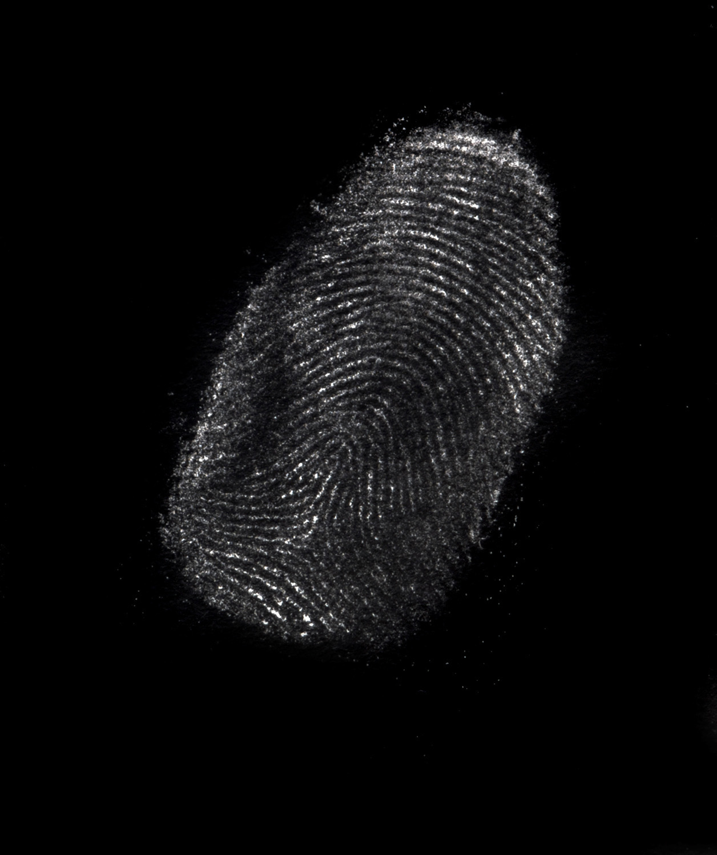
Crime Data Analysis
A broad look at the United States and a closer look at the state of Ohio.
Technologies used: Pandas, Matplotlib and Microsoft Power BI

Slide 2
Process
STEP 1 - DEFINE THE QUESTION:
Did crime increase, particularly larceny/ robbery, burglary and car thefts, during a global pandemic?

Slide 3
Process cont’d
STEP 2 - COLLECT THE DATA:
Dataset retrieved from the Federal Bureau of Investigation Crime Data Explorer.
Source: crime-data-explorer.fr.cloud.gov

Slide 4
Process cont’d
STEP 3 - CLEAN THE DATA:
This dataset was very clean to begin with, so I didn’t have to do too much. Removed a couple of columns, a row and renamed the null values. When I do all of my add-ons, it will be much more tedious and time-consuming.

Slide 5
Process cont’d
STEP 4 - ANALYZE THE DATA:
I looked closer at the state of Ohio and compared the crimes leading up to a global pandemic. Used Matplotlib to make these visual comparisons.

Slide 6
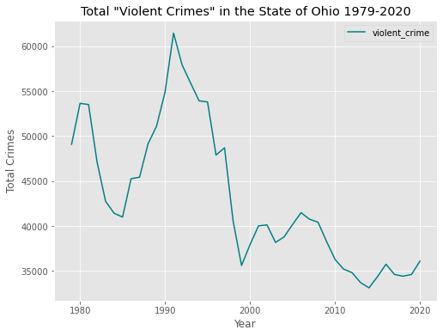
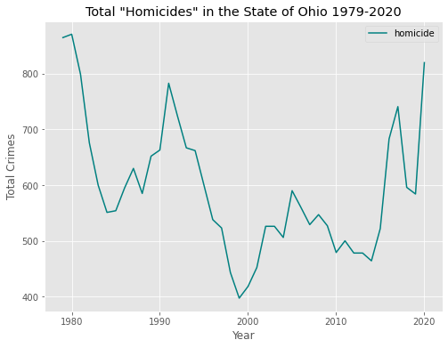

Slide 7
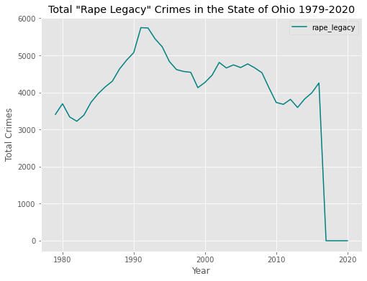
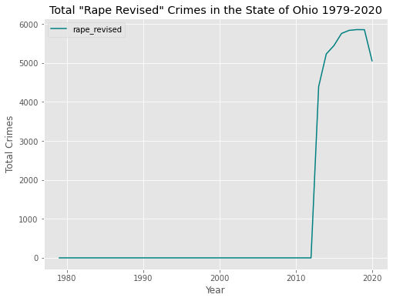

Slide 8
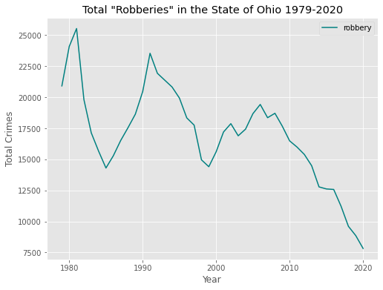
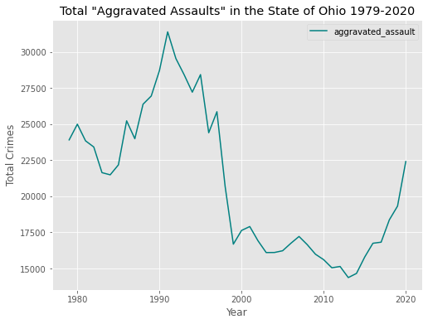

Slide 9
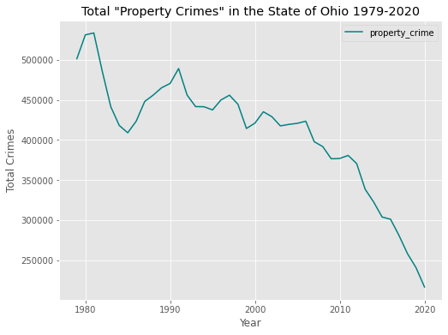
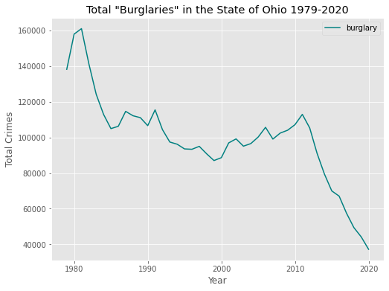

Slide 10
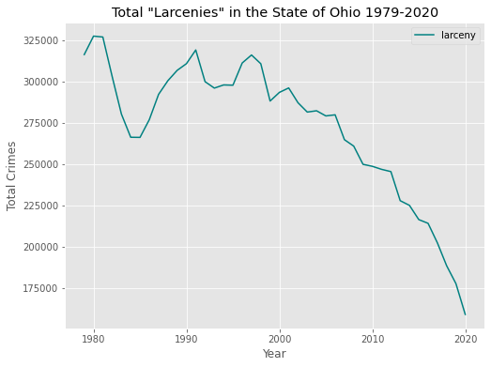
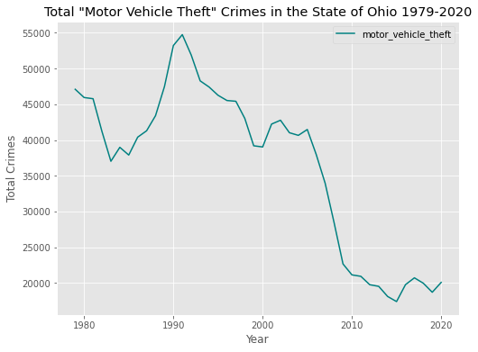

Slide 11
Process cont’d
STEP 5 - VISUALIZE & SHARE THE DATA:
Spent about 10 hours in an exploratory phase, determining the best visualization software for me. (research, Udemy lesson, trial and error)
Tableau – only 14 day free trial, $840/ yr after
Plotly & Dash – didn’t end up providing the look I desired
Microsoft Power BI – 60 day free trial and $10/ mo after

Slide 12
VISUALIZE & SHARE THE DATA
Power BI – a business analytics service by Microsoft. It aims to provide interactive visualizations and business intelligence capabilities with an interface simple enough for end users to create their own reports and dashboards. ~Initial Release July 2011
Azure – a cloud computing service created by Microsoft for building, testing, deploying and managing applications and services through Microsoft-managed data centers. ~Initial Release October 2008

Slide 13
Challenges
Trying to decide on what topic was very challenging for me. I had some other, more interesting topics, but couldn’t find a dataset for.
Choosing which visualization tool to utilize was the most cumbersome portion, however, it was a learning process.

Slide 14
Future Add-ons
~Locate a dataset that has crimes per county in each state
~Add more countries
~Utilize machine learning to predict the trends for future
~Include expanded homicide data (race, age, sex, weapon used, etc.) I currently have that data for 2020 only, so need to locate previous years also.
~Design the mobile version

Slide 15


